Slide 1


Frito-lay
DDSAnalytics: Employee attrition analysis & Prediction
Siddhant Ankolekar
SMU – Data Science
Notes:
Good Afternoon, my name is Siddhant Ankolekar, and today I'll be presenting our employee attrition analysis for Frito-Lay. The goal of this project was to identify the factors associated with employee turnover, develop a model that can predict employees at higher risk of attrition, and estimate the potential financial impact of using that model.

Slide 2
Objective: Understand and Predict Employee Attrition
1
Identify
What factors are associated with employee attrition?
2
Predict
Can we identify employees at higher risk of leaving?
3
Validate
Can the model achieve at least 60% sensitivity and 60% specificity?
4
Quantify
What potential financial savings could targeted retention create?
Metric | Value
Employees | 870
Variables | 36
Employees Leaving | 140
Attrition Rate | 16.1%
Notes:
Frito-Lay asked us to answer four main questions:
First, what factors are associated with employee attrition? Second, can we use those factors to predict which employees are at higher risk of leaving?
Third, can that model meet the required minimum of 60 percent sensitivity and specificity?
And finally, what could the company potentially save by using the model to target retention efforts?
Our analysis began with 870 employees and 36 variables, with 140 employees having left, giving us an overall historical attrition rate of 16.1 percent.

Slide 3
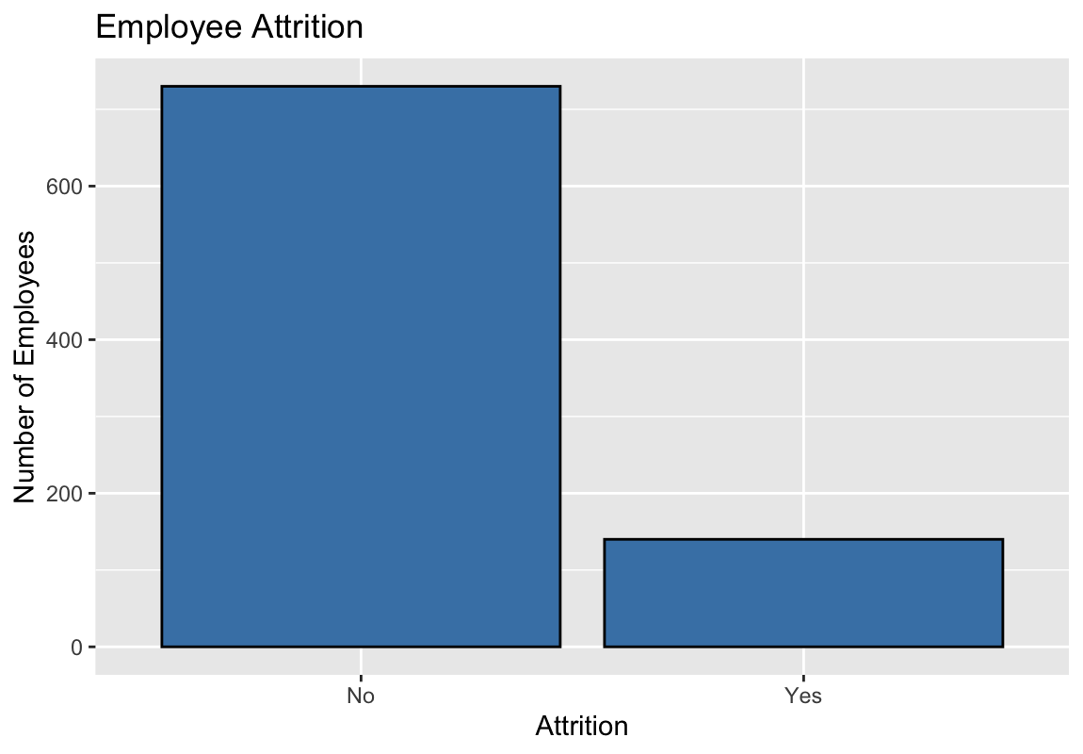
Objective: Data Overview
Variable Categories:
Employee Demographics
Age, Gender, Education
Job Characteristics
Job Role, Job Level, Overtime, Department
Satisfaction
Job Satisfaction, Environment Satisfaction, Work-Life Balance
Compensation
Monthly Income, Salary Hike, Stock Options
Experience
Years at Company, Total Working Years, Years in Current Role
Only 16.1% of employees left.
Notes:
The dataset contained a mix of demographic, job, satisfaction, compensation, and experience variables. We used these variables to train our model. One important characteristic is that attrition is relatively uncommon: only 16.1 percent of employees left, so the model must identify leavers without simply labeling everyone as a non-leaver. That class imbalance is important because a model could achieve high overall accuracy simply by predicting that almost everyone stays. That's why we focus later on sensitivity and specificity rather than accuracy alone.

Slide 4
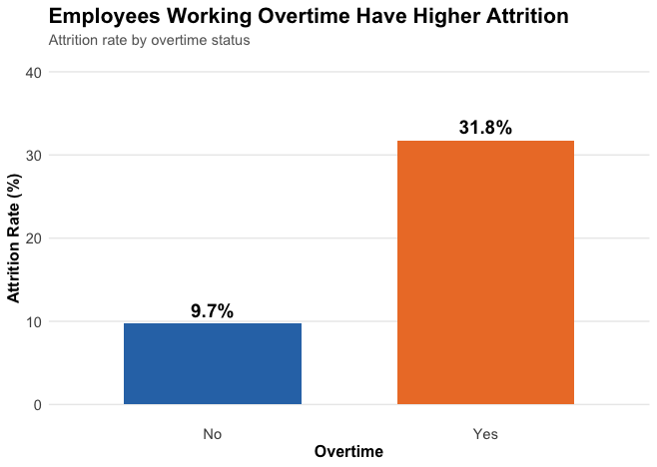
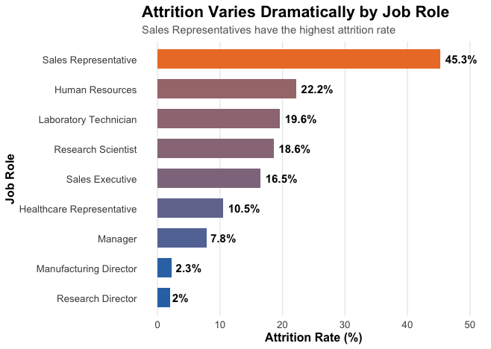
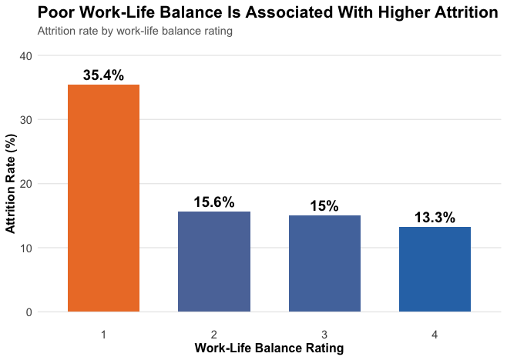
EDA: factors showing elevated attrition
Overtime: 31.8% vs. 9.7%
3.3× higher attrition among overtime employees
Job Role: Sales Representatives have dramatically higher attrition than other job roles
Work-Life Balance: Employees reporting the lowest work-life balance have a 35.4% attrition rate,
Preliminary finding: Employees working overtime, employees in certain job roles, and employees reporting poor work-life balance show substantially higher attrition rates.
Notes:
We first explored the data to identify potential patterns. Overtime stood out immediately: employees working overtime had a 31.8 percent attrition rate compared with 9.7 percent among employees who did not. Attrition also varied substantially by job role, with Sales Representatives experiencing the highest rate at about 45 percent. Finally, employees reporting the lowest work-life balance had a 35.4 percent attrition rate. These are descriptive patterns, so we next tested whether these relationships remained statistically meaningful.

Slide 5
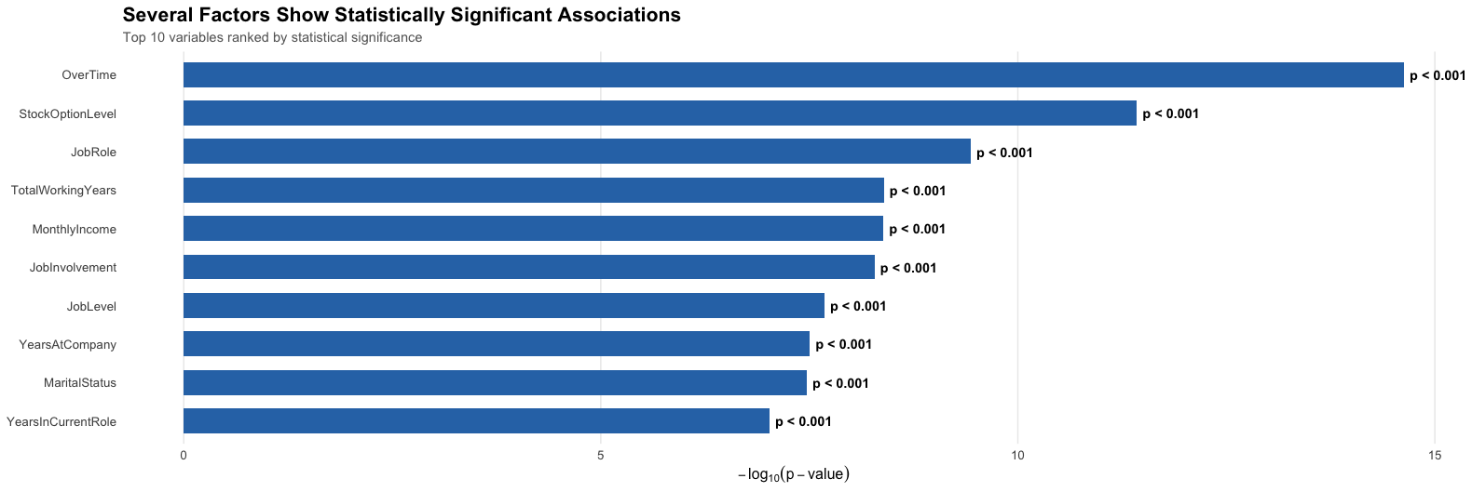
EDA: Top predictors of attrition
Univariate screening identified additional significant factors, but multivariable logistic regression was used to determine which factors remained independently associated.
Notes:
After identifying these preliminary patterns, we conducted formal statistical tests to determine which employee characteristics were significantly associated with attrition.
For categorical variables, such as overtime, job role, and stock option level, we used chi-square tests of independence.
And for numerical variables, such as age, income, and years at the company, we used Wilcoxon rank-sum tests to compare employees who stayed with those who left.
The visualization ranks the variables based on their p-values. Because smaller p-values provide stronger statistical evidence against the assumption of no relationship, longer bars indicate stronger evidence of an association with attrition. This screening process identified a set of variables that were statistically significant and worth carrying forward into our predictive modeling.
Importantly, this chart doesn't tell us which variables are the most important predictors or that any of them cause attrition.
We then considered these variables together in our multivariable models to determine which factors remained independently associated with attrition and whether they could be used to predict employee turnover.

Slide 6
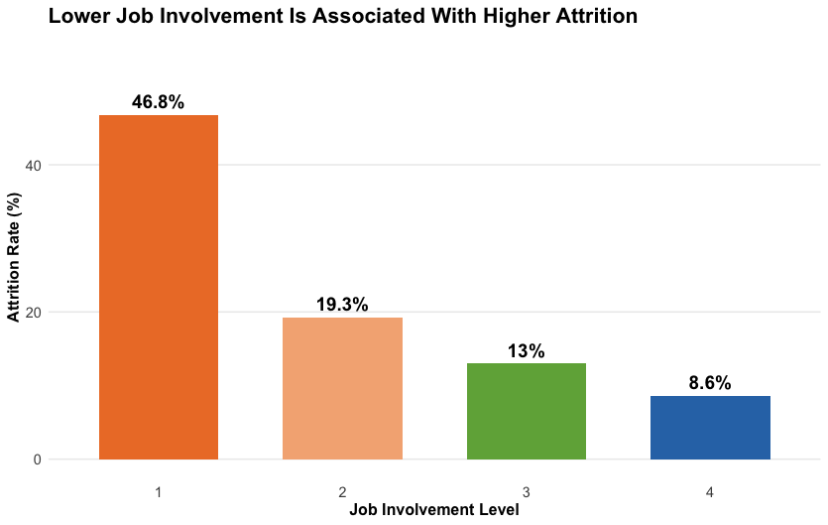
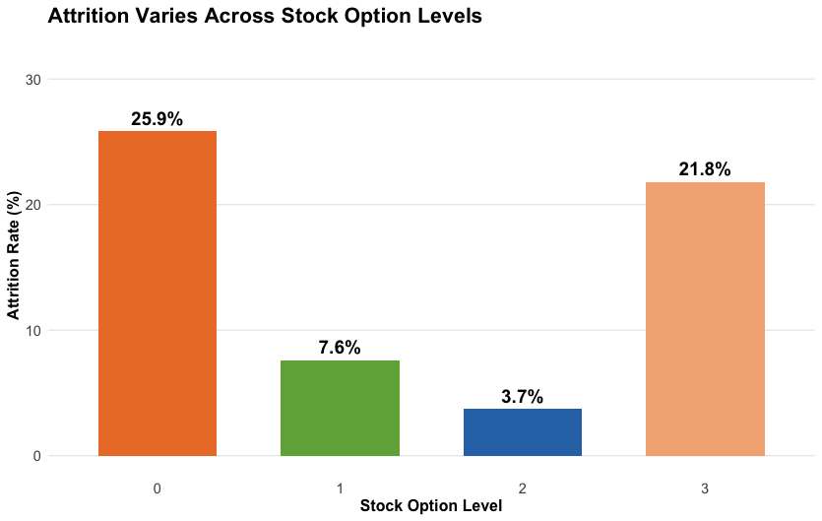
EDA: top 3 factors
Factor | Evidence | Key Finding
OverTime | p < 0.001 | ~5.3× higher odds of attrition
Job Involvement | p < 0.001 | Higher involvement associated with lower attrition
Stock Option Level | p < 0.01 for Levels 1 & 2 | Significant Differences across benefit levels
Notes:
After adjusting for multiple variables simultaneously, three factors stood out as particularly important. Overtime was the strongest finding, with employees working overtime showing approximately 5 times higher odds of attrition. Job involvement was also highly significant, with higher involvement associated with greater retention. Finally, stock option level showed significant differences in attrition across categories. Job role and Work-Life Balance showed promise in the initial findings but when I ran them through the regression model, they did not perform as highly as these three.
So we then wanted to determine whether these predictors could actually be used to identify employees at risk of leaving. For each of the models, thresholds were optimized to meet the case requirement of ≥60% sensitivity and ≥60% specificity.

Slide 7
EDA: KNN Model
KNN classifies an employee based on the outcomes of the most similar employees in the training data.
K = 5
71.4%
Sensitivity
63.5%
Specificity
64.8%
Accuracy
Selected Threshold = 0.20
Notes:
Our first predictive approach was the KNN Model. Rather than estimating a specific relationship between each variable and attrition, KNN looks at employees in the training data who have similar characteristics and uses their outcomes to classify a new employee. We used the same 10 predictors identified during our earlier analysis and tested several values of K. We selected K = 5 as a reasonable starting point for the model.
At the classification threshold we selected, KNN achieved 71.4% sensitivity. It had a specificity of 63.5%, and its overall accuracy was 64.8%. The model therefore met the case requirement of at least 60% sensitivity and specificity. However, its balanced accuracy was only 67.4%, indicating that there was still a tradeoff between identifying employees who leave and correctly identifying employees who stay.

Slide 8
EDA: NB Model
Naive Bayes estimates attrition probability using the observed characteristics of an employee.
61.9%
Sensitivity
69.4%
Specificity
68.2%
Accuracy
Selected Threshold = 0.25
Notes:
Our second approach was Naive Bayes. Unlike KNN, which classifies employees based on similarity to other employees, Naive Bayes calculates the probability of attrition based on the characteristics of each employee. We again used the same 10 predictors so that we could make a fair comparison between models.
Using a 25% probability threshold, Naive Bayes achieved 61.9% sensitivity and 69.4% specificity, with an overall accuracy of 68.2%. This means it also met the case requirement of at least 60% sensitivity and specificity. However, its balanced accuracy was 65.7%.
Naive Bayes also met the minimum requirement, but its balanced accuracy was lower than KNN. Therefore I evaluated a third approach—logistic regression—to see whether I could improve the overall balance while maintaining interpretability

Slide 9
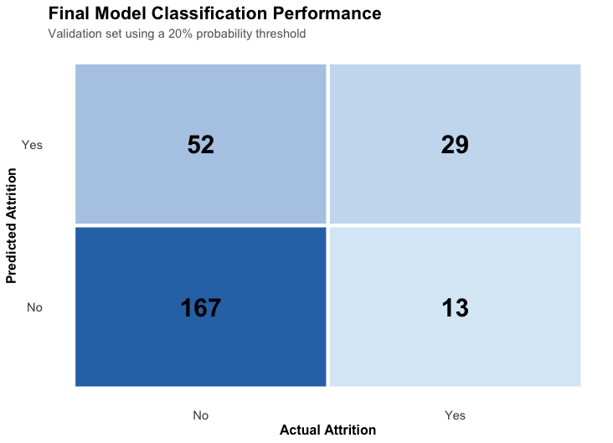
EDA: logistic regression model performance
69.0%
Sensitivity
76.3%
Specificity
75.1%
Accuracy
0.50 Threshold | 33.3% Sensitivity | 97.3% Specificity | ⅹ
0.20 Threshold | 69.0% Sensitivity | 76.3% Specificity | ✓
Notes:
Compared with the other two models, logistic regression gave us the strongest overall balance. It had the highest accuracy and balanced accuracy, while still exceeding the required sensitivity and specificity thresholds. In addition, it allowed us to interpret the relationship between the employee characteristics and attrition, which was important from a business perspective. For those reasons, we selected logistic regression as our final model.
This confusion matrix shows the model's performance on the held-out validation data using a 20 percent threshold.
The reason I used a 20 percent threshold is because at the standard 50 percent threshold, the model had high specificity but only 33 percent sensitivity, meaning it missed too many employees who left.
We therefore evaluated alternative probability thresholds. Leading us to the 20 percent threshold, which met the case requirement of at least 60 percent for both metrics.
The model correctly identified 29 of the 42 employees who actually left, giving us 69 percent sensitivity.
It correctly identified 167 of the 219 employees who stayed, giving us 76 percent specificity.
And lastly, it was about 75.1 percent accurate.

Slide 10
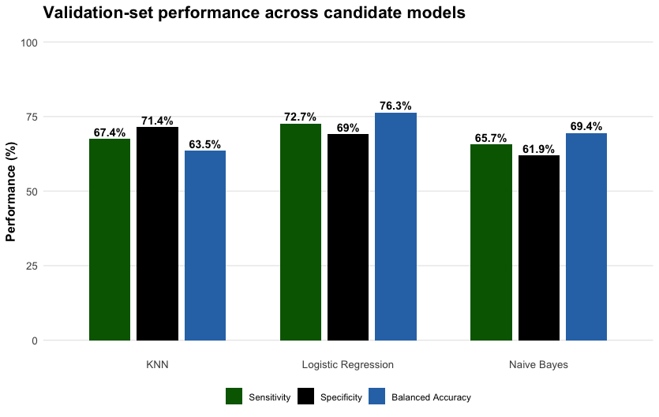
EDA: predictive modeling strategy
Notes:
Here we can see the three models being compared side-by-side with their respective sensitivity, specificity and balanced accuracy values. Remember that accuracy measures the percentage of all predictions that were correct, while balanced accuracy gives equal weight to identifying employees who leave and employees who stay. Because attrition is an imbalanced outcome, balanced accuracy is a more informative measure of our model's overall performance since it averages sensitivity and specificity.

Slide 11
EDA: predictive modeling strategy
Model | Threshold | Sensitivity | Specificity | Accuracy | Balanced Accuracy
Logistic Regression | 0.20 | 69.0% | 76.3% | 75.1% | 72.7%
KNN | 0.10–0.20 | 71.4% | 63.5% | 64.8% | 67.4%
Naive Bayes | 0.25 | 61.9% | 69.4% | 68.2% | 65.7%
Notes:
An important note is that the model also adjusted the classification threshold because the standard 50 percent threshold produced insufficient sensitivity.
The final model for regression used a 20 percent threshold, which allowed us to identify more potential leavers while still maintaining acceptable specificity.
And while it wasnt the highest on sensitivity, it had the best balanced accuracy and strongest overall balance between sensitivity and specificity among the three, which is why I selected it.

Slide 12
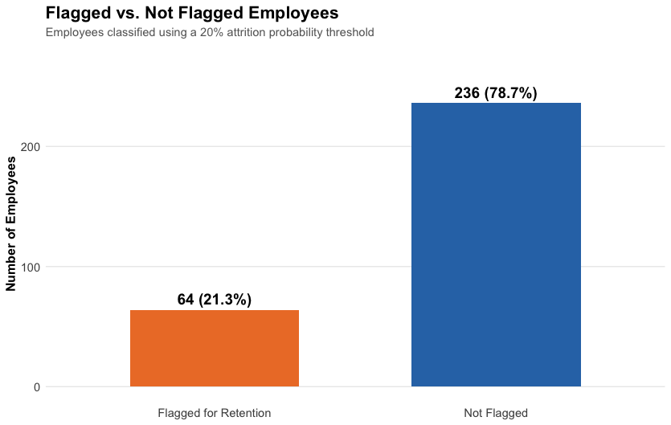
Competition prediction
300 employees
Logistic Regression Model
64 Flagged
236 Not Flagged
20% Risk Threshold
Notes:
I then applied the model to the 300 employees in the competition dataset. Using our regression model and the 20 percent threshold, 64 employees were flagged as higher risk, representing 21.3 percent of the population.
These employees will be the target of a retention intervention.

Slide 13
Financial impact: targeted retention creates Significant Potential Financial Value
64 Employees flagged | $12.8K Intervention cost | $2.13M Potential net savings
300 Employees -> 64 Flagged by Model ->
Retention Intervention ($200 x 64= $12,800) ->
32 Employees Retained (50% Intervention Success) ->
$2.14M Avoided Replacement Cost ->
$2.13M Net Savings
Intervention success | Employees retained | 50% replacement | 100% replacement | 200% replacement | 400% replacement
25% | 16 | $522K | $1.057M | $2.127M | $4.266M
50% | 32 | $1.057M | $2.127M | $4.266M | $8.545M
75% | 48 | $1.592M | $3.196M | $6.406M | $12.824M
100% | 64 | $2.127M | $4.266M | $8.545M | $17.103M
Notes:
The financial analysis connects the model directly to the business decision. The company would spend $200 per flagged employee, or $12,800 for all 64 employees.
In our middle scenario, if the intervention successfully retains half of those employees and replacing an employee costs 100 percent of annual salary, the company could avoid approximately $2.14 million in replacement costs, resulting in approximately $2.13 million in net potential savings.
The broader scenario analysis shows that the potential value remains substantial across different retention and replacement-cost assumptions.

Slide 14
Targeted Retention Strategies Can Reduce Attrition risk
1)
Reduce Overtime Risk:
5.3× higher odds of attrition
Recommendation: Monitor Overtime and Workload
2)
Strengthen Engagement:
p < 0.001
Recommendation: Increase Involvement and Engagement
3)
Target Benefits & Incentives:
p < 0.01
Recommendation: Review benefits for high-risk employees
Model-Driven Retention Program
Predict → Identify → Intervene → Measure → Refine
Potential Value
64 Flagged Employees
$12.8K Intervention Investment
$2.13M Potential Net Savings
Notes:
Based on the analysis, I would recommend a targeted strategy rather than company-wide retention strategy.
First, Frito-Lay should monitor overtime among high-risk employees.
Second, the company should strengthen employee involvement through engagement and development initiatives.
Third, benefits and retention incentives can be targeted toward employees identified as high risk.
The key is to use the model as an early-warning system, intervene, measure the results, and continuously refine the approach.
And by doing so, as mentioned before, the potential net savings could be approx. $2Million

Slide 15
Executive summary
Identify
870 employees analyzed
16.1% Attrition
Predict
Logistic Regression
Target
64 of 300 Flagged
Impact
$2.13M Potential Net Savings
MONITOR → INTERVENE → MEASURE → REFINE
Use predictive analytics to identify high-risk employees and prioritize targeted retention interventions.
Notes:
To conclude, we started with 870 employees and identified the factors most associated with attrition.
We developed a logistic regression model that met the required sensitivity and specificity thresholds.
When applied to the competition population, the model identified 64 employees for targeted intervention.
Under our financial scenario, that creates approximately $2.13 million in potential net savings.
The overall recommendation is to use predictive analytics as an early-warning system to focus retention resources where they can have the greatest potential impact.
Once again, my name is Siddhant. Thank you for your time and I'm happy to answer any questions!

